Slide 1
Basic concepts of set theory

Slide 2
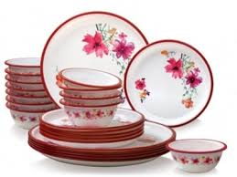
Definitions
Description: a set is a collection of objects. The objects are called the elements of that set.
A diner set
Set of integers I={0, 1, 2, …}
Set of odd integers less than 10; J={1,3,5,7,9}
J={j|j is an odd integer <10}
Set of outcomes of an experiments
(data set) Taken from Google Images

Slide 3
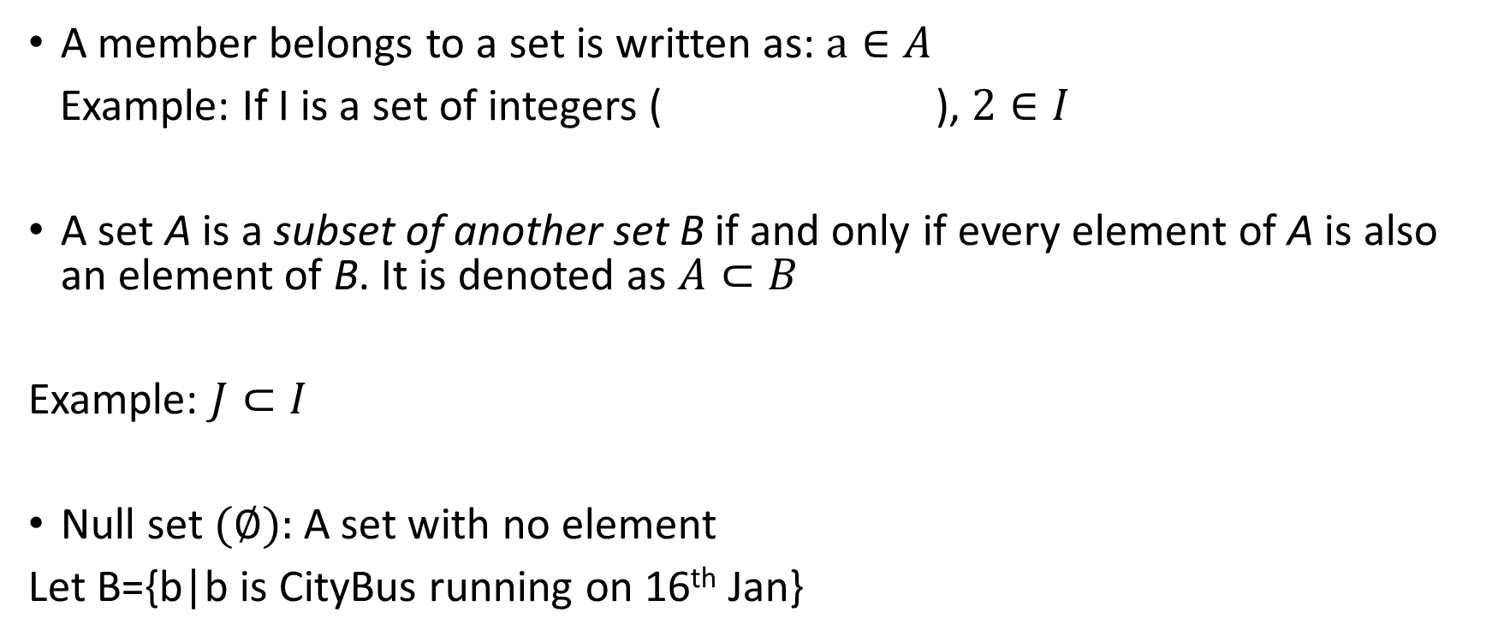
Belonging, Subset and Null set
A member belongs to a set is written as: $a∈A$
Example: If I is a set of integers ( ), $2∈I$
A set A is a subset of another set B if and only if every element of A is also an element of B. It is denoted as $A⊂B$
Example: $J⊂I$
Null set $(∅):$ A set with no element
Let B={b|b is CityBus running on 16th Jan}
I={0, 1, 2, …}
J={1,3,5,7,9}

Slide 4
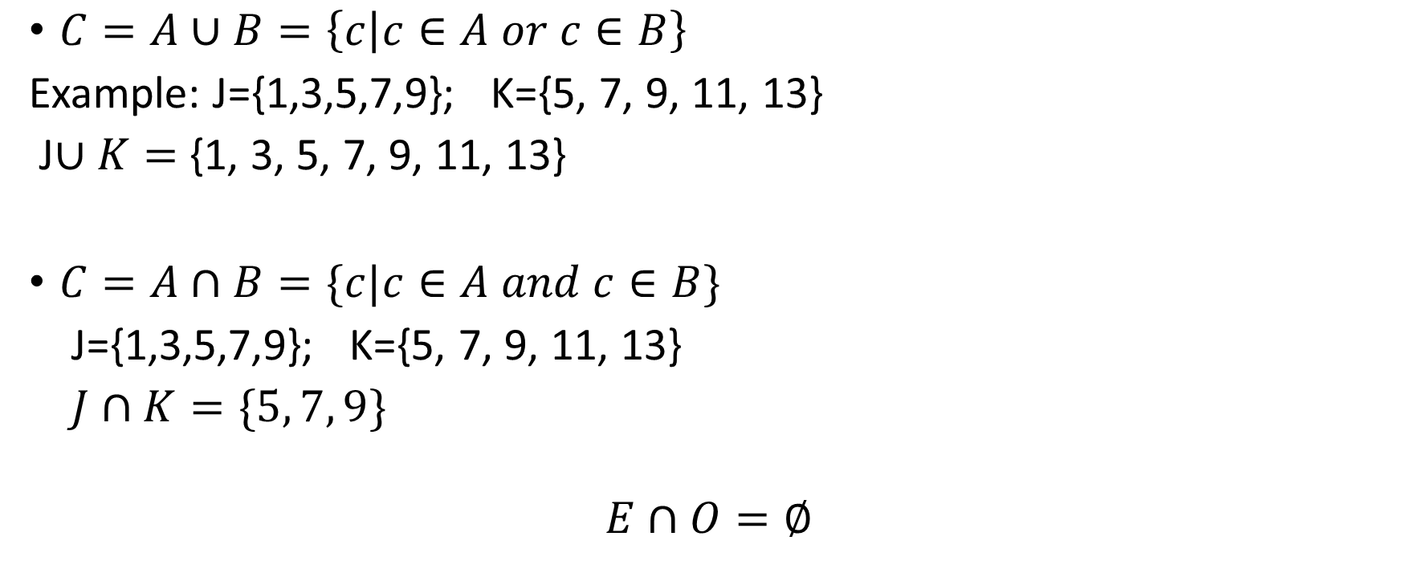
Union and intersection
$C=A∪B=\left\{c | c∈A or c∈B\right\}$
Example: J={1,3,5,7,9}; K={5, 7, 9, 11, 13}
J$∪K=$ {1, 3, 5, 7, 9, 11, 13}
$C=A∩B=\{c|c∈A and c∈B\}$
J={1,3,5,7,9}; K={5, 7, 9, 11, 13}
$J∩K=\{5, 7, 9\}$
$$E∩O=∅$$

Slide 5

Mutually exclusive sets
$A∪B=A+B−A∩B$ $A∪B=A+B$

